Slide 1

Week 6: Recursion
CS/COE 0445 - Data Structures
Sherif Khattab
http://www.cs.pitt.edu/~skhattab/cs0445
(Some slide contents are © 2016 Pearson Education, Ltd. All rights reserved.
Others are from Dr. Ramirez’s CS 445 course)

Slide 2
Administrivia
Assignment 2 due on Mon. 2/19 @11:59pm

Slide 3
Agenda
Review of last lecture’s activity
Recursion

Slide 4
What Is Recursion?
Consider hiring a contractor to build
He hires a subcontractor for a portion of the job
That subcontractor hires a sub-subcontractor to do a smaller portion of job
The last sub-sub- … subcontractor finishes
Each one finishes and reports “done” up the line

Slide 5
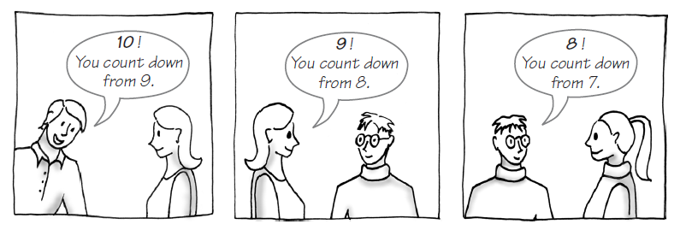
Example: The Countdown
FIGURE 7-1 Counting down from 10

Slide 6
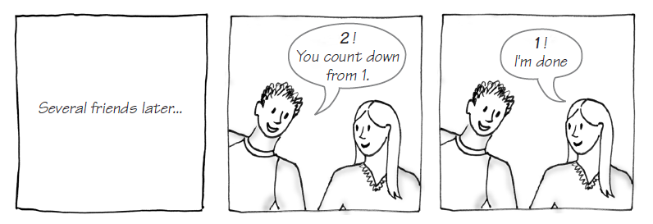
Example: The Countdown
FIGURE 7-1 Counting down from 10

Slide 7
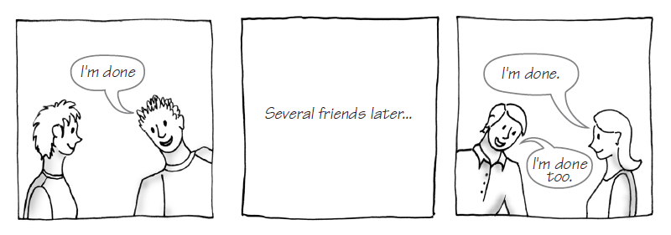
Example: The Countdown
FIGURE 7-1 Counting down from 10

Slide 8
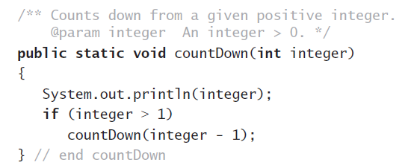
Example: The Countdown
Recursive Java method to do countdown.

Slide 9
Definition
Recursion is a problem-solving process
Breaks a problem into identical but smaller problems.
A method that calls itself is a recursive method.
The invocation is a recursive call or recursive invocation.

Slide 10
Design Guidelines
Method must be given an input value
Method definition must contain logic that involves this input, leads to different cases
One or more cases should provide solution that does not require recursion
Else infinite recursion
One or more cases must include a recursive invocation

Slide 11
Programming Tip
Iterative method contains a loop
Recursive method calls itself
Some recursive methods contain a loop and call themselves
If the recursive method with loop uses while, make sure you did not mean to use an if statement

Slide 12
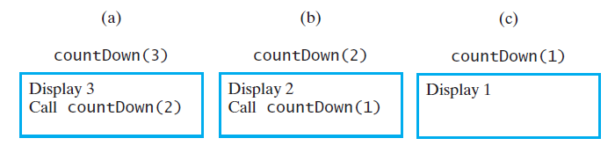
Tracing a Recursive Method
FIGURE 7-2 The effect of the method call countDown(3)

Slide 13
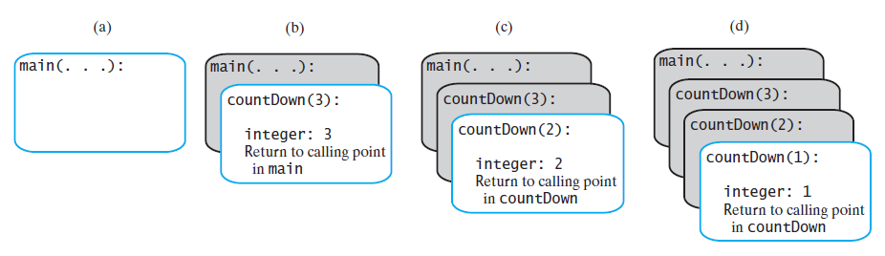
Tracing a Recursive Method
FIGURE 7-4 The stack of activation records during the execution of the call countDown(3)

Slide 14
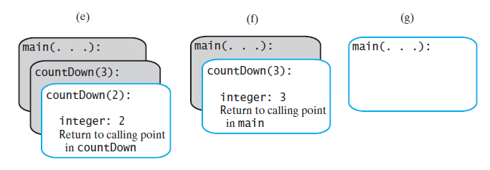
Tracing a Recursive Method
FIGURE 7-4 The stack of activation records during the execution of the call countDown(3)

Slide 15
Stack of Activation Records
Each call to a method generates an activation record
Recursive method uses more memory than an iterative method
Each recursive call generates an activation record
If recursive call generates too many activation records, could cause stack overflow

Slide 16
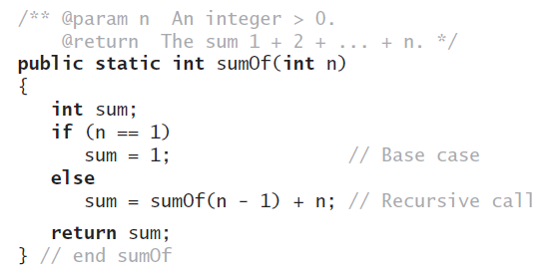

Recursive MethodsThat Return a Value
Recursive method to calculate

Slide 17
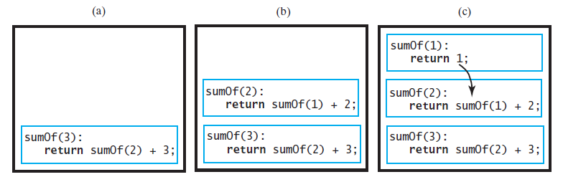
Tracing a Recursive Method
FIGURE 7-5 Tracing the execution of sumOf(3)

Slide 18
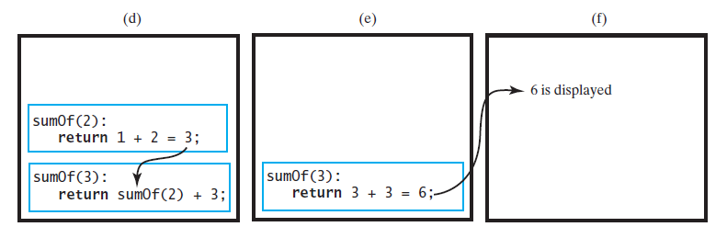
Tracing a Recursive Method
FIGURE 7-5 Tracing the execution of sumOf(3)

Slide 19
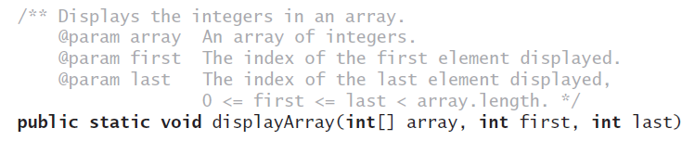
Recursively Processing an Array
Given definition of a recursive method to display array.

Slide 20
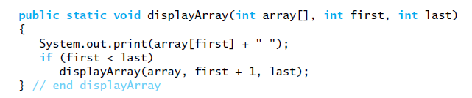
Recursively Processing an Array
Starting with array[first]

Slide 21
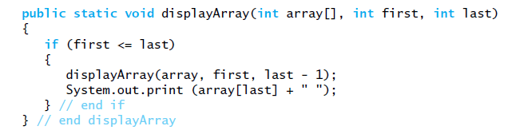
Recursively Processing an Array
Starting with array[last]

Slide 22

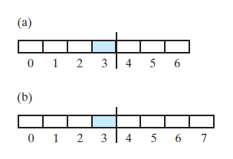
Recursively Processing an Array
FIGURE 7-6 Two arrays with their middle elements within their left halves

Slide 23
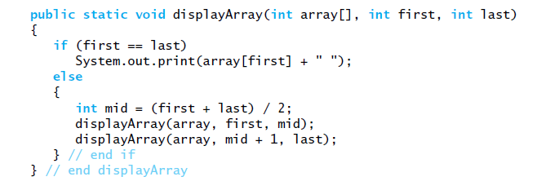
Recursively Processing an Array
Processing array from middle.
Consider first + (last – first) / 2 Why?

Slide 24
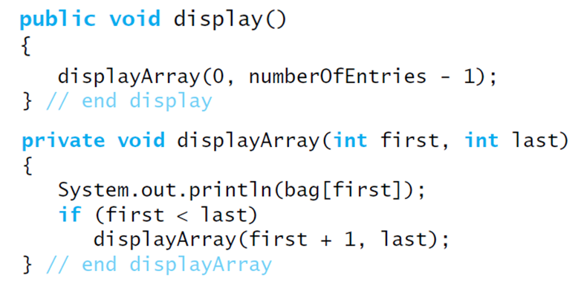
Displaying a Bag
Recursive method that is part of an implementation of an ADT often is private.

Slide 25
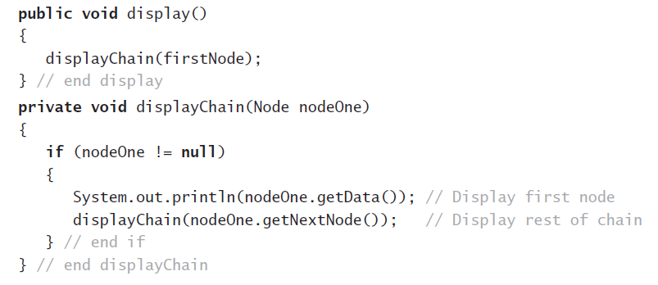
Recursively Processing a Linked Chain
Display data in first node and recursively display data in rest of chain.

Slide 26
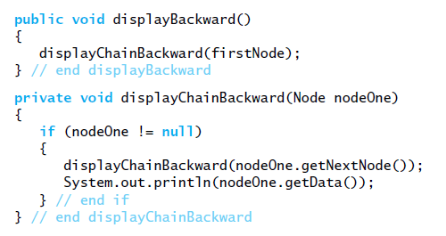
Recursively Processing a Linked Chain
Displaying a chain backwards. Traversing chain of linked nodes in reverse order easier when done recursively.

Slide 27
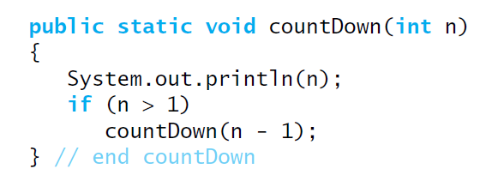
Recursively Processing a Linked Chain
Using proof by induction, we conclude method is O(n).

Slide 28
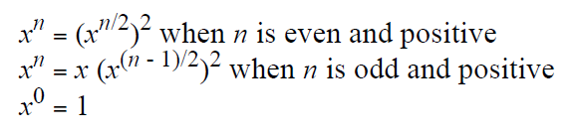
Time Efficiency of Computing x^{n}
Efficiency of algorithm is O(log n)

Slide 29
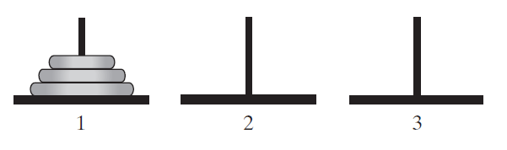
Simple Solution to a Difficult Problem
FIGURE 7-7 The initial configuration of the Towers of Hanoi for three disks.

Slide 30
Simple Solution to a Difficult Problem
Rules:
Move one disk at a time. Each disk moved must be topmost disk.
No disk may rest on top of a disk smaller than itself.
You can store disks on the second pole temporarily, as long as you observe the previous two rules.

Slide 31
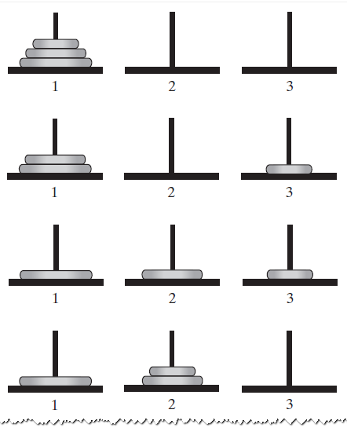
Solutions
FIGURE 7-8 The sequence of moves for solving the Towers of Hanoi problem with three disks

Slide 32
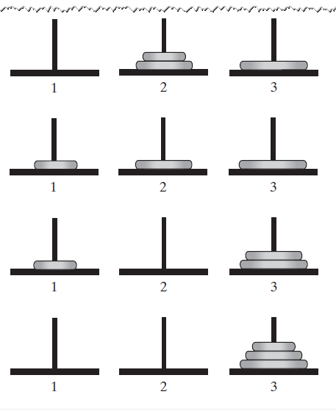
Solutions
FIGURE 7-8 The sequence of moves for solving the Towers of Hanoi problem with three disks

Slide 33
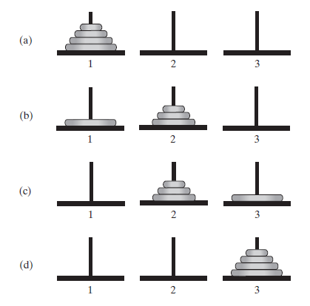
Solutions
FIGURE 7-9 The smaller problems in a recursive solution for four disks

Slide 34
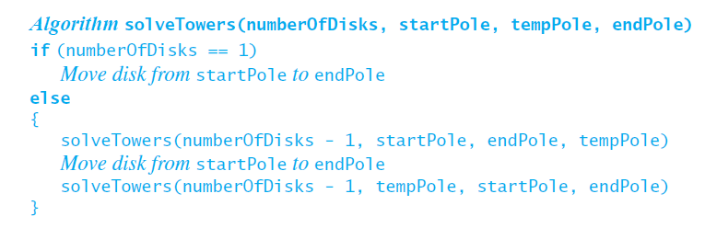
Solutions
Recursive algorithm to solve any number of disks. Note: for n disks, solution will be 2^{n} – 1 moves

Slide 35
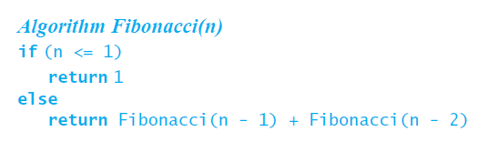
Poor Solution to a Simple Problem
Algorithm to generate Fibonacci numbers.
Why is this inefficient?

Slide 36
Single recursion
A recursive algorithm with a single recursive call still provides a linear chain of calls
Calls build run-time stack
Stack shrinks as calls finish

Slide 37
Double recursion
When a recursive algorithm has 2 calls, the execution trace is now a binary tree, as we saw with the trace on the board
This is execution is more difficult to do without recursion
To do it, programmer must create and maintain his/her own stack to keep all of the various data values
This increases the likelihood of errors / bugs in the code
Later we will see some other classic recursive algorithms with multiple calls
Ex: MergeSort, QuickSort
Notes:
Note: We will discuss binary trees in detail later

Slide 38
Poor Solution to a Simple Problem
Algorithm to generate Fibonacci numbers.
Why is this inefficient?

Slide 39
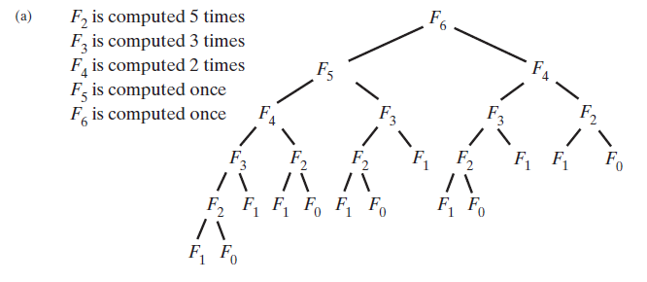
Poor Solution to a Simple Problem
The computation of the Fibonacci number F₆ using (a) recursion … F_{n} = Ω(2^{n})

Slide 40
Converting Recursion into Iteration
Can we tell if a recursive algorithm can be easily done in an iterative way?
Yes – any recursive algorithm that is exclusively tail recursive can be done simply using iteration without recursion
Most algorithms we have seen so far are exclusively tail recursive

Slide 41
Tail Recursion
So what is tail recursion?
Recursive algorithm in which the recursive call is the LAST statement in a call of the method
What are the implications of tail recursion?
Any tail recursive algorithm can be converted into an iterative algorithm in a methodical way
In fact some compilers do this automatically

Slide 42
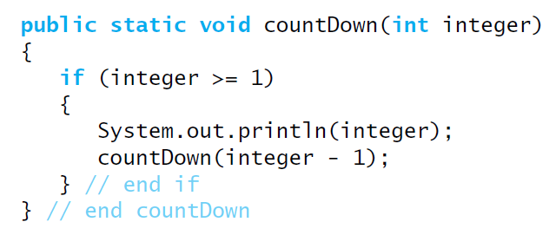
Tail Recursion
When the last action performed by a recursive method is a recursive call.

Slide 43
Tail Recursion
In a tail-recursive method, the last action is a recursive call
This call performs a repetition that can be done by using iteration.
Converting a tail-recursive method to an iterative one is usually a straightforward process.

Slide 44
Converting to tail-recursion
Examples (Done on board)
Power
Fibonacci
Towers of Hanoi

Slide 45
Converting tail-recursion into iteration
Examples (Done on board)
CountDown
Power
Fibonacci
Towers of Hanoi

Slide 46
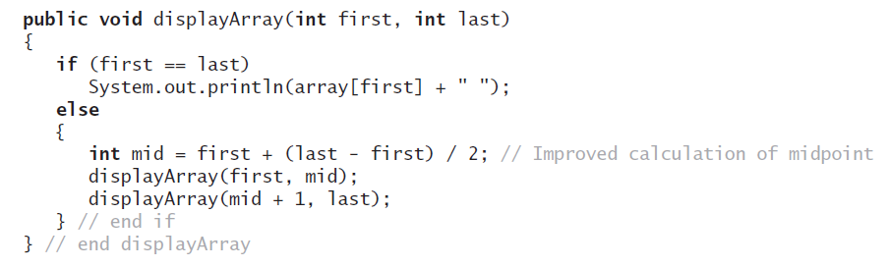
Using a Stack Instead of Recursion
An example of converting a recursive method to an iterative one

Slide 47
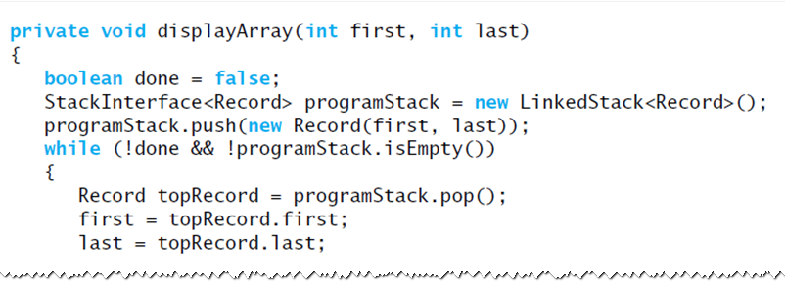
Using a Stack Instead of Recursion
An iterative displayArray to maintain its own stack

Slide 48
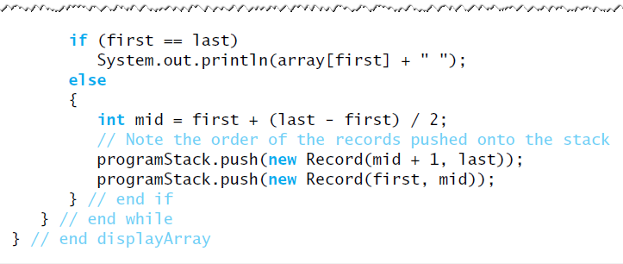
Using a Stack Instead of Recursion
An iterative displayArray to maintain its own stack

Slide 49
Using a Stack Instead of Recursion
An iterative displayArray to maintain its own stack

Slide 50
Another example
Towers of Hanoi
Check “Recursion to Iteration” handout

Slide 51
Overhead of Recursion
Why do we care?
Recursive algorithms have overhead associated with them
Space: each activation record (AR) takes up memory in the run-time stack (RTS)
If too many calls "stack up" memory can be a problem
Time: generating ARs and manipulating the RTS takes time
A recursive algorithm will always run more slowly than an equivalent iterative version

Slide 52
Recursion and Divide and Conquer
Divide and Conquer
The idea is that a problem can be solved by breaking it down to one or more "smaller" problems in a systematic way
Usually the subproblem(s) are a fraction of the size of the original problem
Usually the subproblems(s) are identical in nature to the original problem
It is fairly clear why these algorithms can typically be solved quite nicely using recursion

Slide 53
Recursion and Divide and Conquer
We can think of each lower level as solving the same problem as the level above
The only difference in each level is the size of the problem, which is ½ of that of the level above it
Note how quickly the problem size is reduced

Slide 54
Recursion and Divide and Conquer
How can we apply this to the Power fn?
We typically need to consider two important things:
How do we break up or "divide" the problem into subproblems?
In other words, what do we do to the data to process it before making our recursive call(s)?
How do we use the solutions of the subproblems to generate the solution of the original problem?
In other words, after the recursive calls complete, what do we do with the results?
For X^{N} the problem "size" is the exponent, N
So a subproblem would be the same problem with a smaller N

Slide 55
Recursion and Divide and Conquer
Let's try cutting N in half – use N/2
1) We want to define X^{N} somehow in terms of X^{N/2}
We can't forget the base case
2) We need to determine how the original problem is solved in terms of the solution X^{N/2}
Done on board (and see notes below)
Will this be an improvement over the other version of the function?
It seems like it since the problem is being cut in half each time
Informal analysis shows we only need O(log₂N) multiplications in this case (see text)
Notes:
X^{N} = (X^{N/2})²
Ok, but we need a base case as always
We can use the same as before: X⁰ = 1
But will this always work? We need to make sure that our solution is always correct.
Let's try 2³ = (2¹)² = ((2⁰)²)² = (1²)² = 1
What went wrong? Well the solution above works only when the exponent is EVEN. If the exponent is odd, due to integer division truncation, we lose information. We need a different case here. Let's try again
X^{N} = (X^{N/2})² when N is even and > 0
= X * (X^{N/2})² when N is odd and > 0
= 1 when N = 0

Slide 56
Overhead of Recursion
So what else is recursion good for?
For some problems, a recursive approach is more natural and simpler to understand than an iterative approach
Once the algorithm is developed, if it is tail recursive, we can always convert it into a faster iterative version
For some problems, it is very difficult to even conceive an iterative approach, especially if multiple recursive calls are required in the recursive solution
Example: Backtracking problems

Slide 57
Recursion and Backtracking
Idea of backtracking:
Proceed forward to a solution until it becomes apparent that no solution can be achieved along the current path
At that point UNDO the solution (backtrack) to a point where we can again proceed forward
Example: 8 Queens Problem
How can I place 8 queens on a chessboard such that no queen can take any other in the next move?
Recall that queens can move horizontally, vertically or diagonally for multiple spaces

Slide 58
8 Queens Problem
How can we solve this with recursion and backtracking?
We note that all queens must be in different rows and different columns, so each row and each column must have exactly one queen when we are finished
Complicating it a bit is the fact that queens can move diagonally
So, thinking recursively, we see the following
To place 8 queens on the board we need to
Place a queen in a legal (row, column)
Recursively place 7 queens on the rest of the board
Where does backtracking come in?
Our initial choices may not lead to a solution – we need a way to undo a choice and try another one

Slide 59
8 Queens Problem
Using this approach we come up with the solution as shown in 8-Queens handout
8Queens.java
Idea of solution:
Each recursive call attempts to place a queen in a specific column
A loop is used, since there are 8 squares in the column
For a given call, the state of the board from previous placements is known (i.e. where are the other queens?)
This is used to determine if a square is legal or not
If a placement within the column does not lead to a solution, the queen is removed and moved "down" the column

Slide 60
8 Queens Problem
When all rows in a column have been tried, the call terminates and backtracks to the previous call (in the previous column)
If a queen cannot be placed into column i, do not even try to place one onto column i+1 – rather, backtrack to column i-1 and move the queen that had been placed there
See handout for code details
Why is this difficult to do iteratively?
We need to store a lot of state information as we try (and un-try) many locations on the board
For each column so far, where has a queen been placed?

Slide 61
8 Queens Problem
The run-time stack does this automatically for us via activation records
Without recursion, we would need to store / update this information ourselves
This can be done (using our own Stack rather than the run-time stack), but since the mechanism is already built into recursive programming, why not utilize it?
There are many other famous backtracking problems
http://en.wikipedia.org/wiki/Backtracking

